Slide 1
Hypercapnia Research Group
Jan 6 Meeting

Slide 2
Goal of project
Hypothesis 1: Commonly used methods of identifying hypercapnia identify different patients, and those patients differ in ways expected to influence prognosis and distribution of effect modifiers to treatments.
  Question: how best to demonstrate this difference?
    Principal Components are Hard to Understand
    Stratification by a few key covarites (e.g. age, gender) by frequency of causative diagnoses. (or other features too?)
    → idea, this improved stratification might allow better ‘conditional’ estimates knowing a patients comorbidities/clinical circumstance (as compared to more ‘marginal’ estimates that apply to the entire population.
Notes:
“. A well-defined descriptive question aims to quantify and characterize some feature of the health of a population and must clearly state: 1) the target population, characterized by person and place, and anchored in time; 2) the outcome, event, or health state or characteristic; and 3) the measure of occurrence that will be used to summarize the outcome (e.g., incidence, prevalence, average time to event, etc.). Additionally, 4) any auxiliary variables will be prespecified and their roles as stratification factors (to characterize the outcome distribution) or nuisance variables (to be standardized over) will be stated.” https://academic.oup.com/aje/article/191/12/2063/6623869
Target population: hospitalized adult inpatients at academic medical centers across the US (note, this sampling frame has the referral patterns to AMC and the symptoms that cause symptoms warranting hospitalization baked in – ie. acute > chronic, etc.)
Outcome/event/characteristic: hypercapnic respiratory failure (defined as a PaCO2 over 45 mmHg, had it been checked)
Point Prevalence upon admission to hospital (remember, cross-sectional study)
Auxillary variables: age, gender. Nuisance variables: comorbidities(?), region(?)
Study Design: cross-sectional
The ‘analytic sample’ = the sample with sufficient data to be included. This is the question we need to answer…. How to narrow the target sample (all patients who would be hospitalized at an academic medical center if they developed hypercapnia) to the analytic frame (patients who either have or can be imputed the necessary covariate: need key comorbidities, labs, etc. to be reported for the encounter in question…. It’s probably enough if the category is represented (ie. selective reporting of some types of info would be odd)
Inferences required for analytic sample to represent target sample: selection bias? Mechanism of data missingness
“Independent association” – will likely want to avoid this and only adjust on a few key covariates (e.g. age and sex) and away a few key nuisance variables (such as location). “Conversely, when trying to understand whether one covariate is associated with the distribution of disease independently or merely because of its correlation with another covariate, a common approach is to put all covariates into a single model. However, this approach can lead to incorrect interpretations of the results and inappropriate recommendations for actions” “We endorse reporting and primary interpretation of unadjusted results for descriptive studies and clear justification and proper interpretation in cases where adjustments are made.”

Slide 3
Hypothesis 2: We can construct methods that select a more representative sample of patients (would require expanded data)
  In some sense, the fundamental problem of the research endeavor is that the reference standard diagnostic test (ABG) is frequently missing
    Modeling P(obtaining ABG) and P(Hypercapnia | ABG obtained) may be one avenue.
  Partial verification formulation: clinicians only seek a reference standard test in cases where some other features suggest hypercapnia is likely
    If you make certain assumptions… can you do better? IPW can extend things to work if data is assumed to be missing at random. To what extent is it?
    in order to know if that assumption is valid (enough), you’d need a gold standard reference… which would require prospective study on the population of interest (enriched population)
Notes:
Propensity analysis thoughts:
propensity score for obtaining gold standard—> creation of a pseudo population using inverse probability weights that approximates if everyone had received a blood gas. Valid to the extent that propensity score captures all factors related to (probabg and prob hypercap?) - all variation not captured should be instrumental (is this condition independence?). Pseudo population has same distribution of propensity score.
———stratification of p(hypercap) by propensity score =estimate how good docs are (would you be able to sep other indications for ABg like met acidosis?)
—- could you validate whether p(abg) changes the likelihood of NIV or Dx code?
——///- conceptualization as an extreme partial verification prob? (Vs, better to use multiple imputation??)
———- abg proneness of the hospital or unit (or doc) might be an acceptable instrument
Two paradigms: can consider this as a measurement error problem (we have an imperfect gold standard) or a missing data problem (an ideal study would have a column for admission gold standard ABG… but we just don’t have that). [and, in some sense, even the PaCO2 isn’t really gold standard for what we’re after, which is frailty of the ventilatory control system – sensors and effectors - to adequately defend CO2 from threats to homeostasis. Which it is interesting to think about what FN and FP are in this context.)
Justification for reweighting:
“Analyzing the study sample as if it were a random sample of the target population is akin to assuming that data are missing completely at random. If, instead, it is plausible to assume that data are missing at random conditional on covariates that are available for target population members who were not selected for the study sample, we could reweight or standardize the study sample to represent the full target population.”

Slide 4
Hypothesis 3: validate how well hypercapnia definitions that can be based on features that can be created from other datasets (e.g. NIS) would perform and whether they are usable.

Slide 5
Data pre-processing
Missing data: For hypercapnia icd codes, treatment modalities, and ABG results -> the missingness of the data is a feature of interest
  For other features: should we impute?
Notes:
Data preprocessing aims to clean the dataset for anomalies (outliers or very noisy data), missing and imprecise values.⁵² The relevant variables should be found, and corresponding features should be formed with individual features processing a similar scale level.
We only use static features. (no dynamic features).

Slide 6
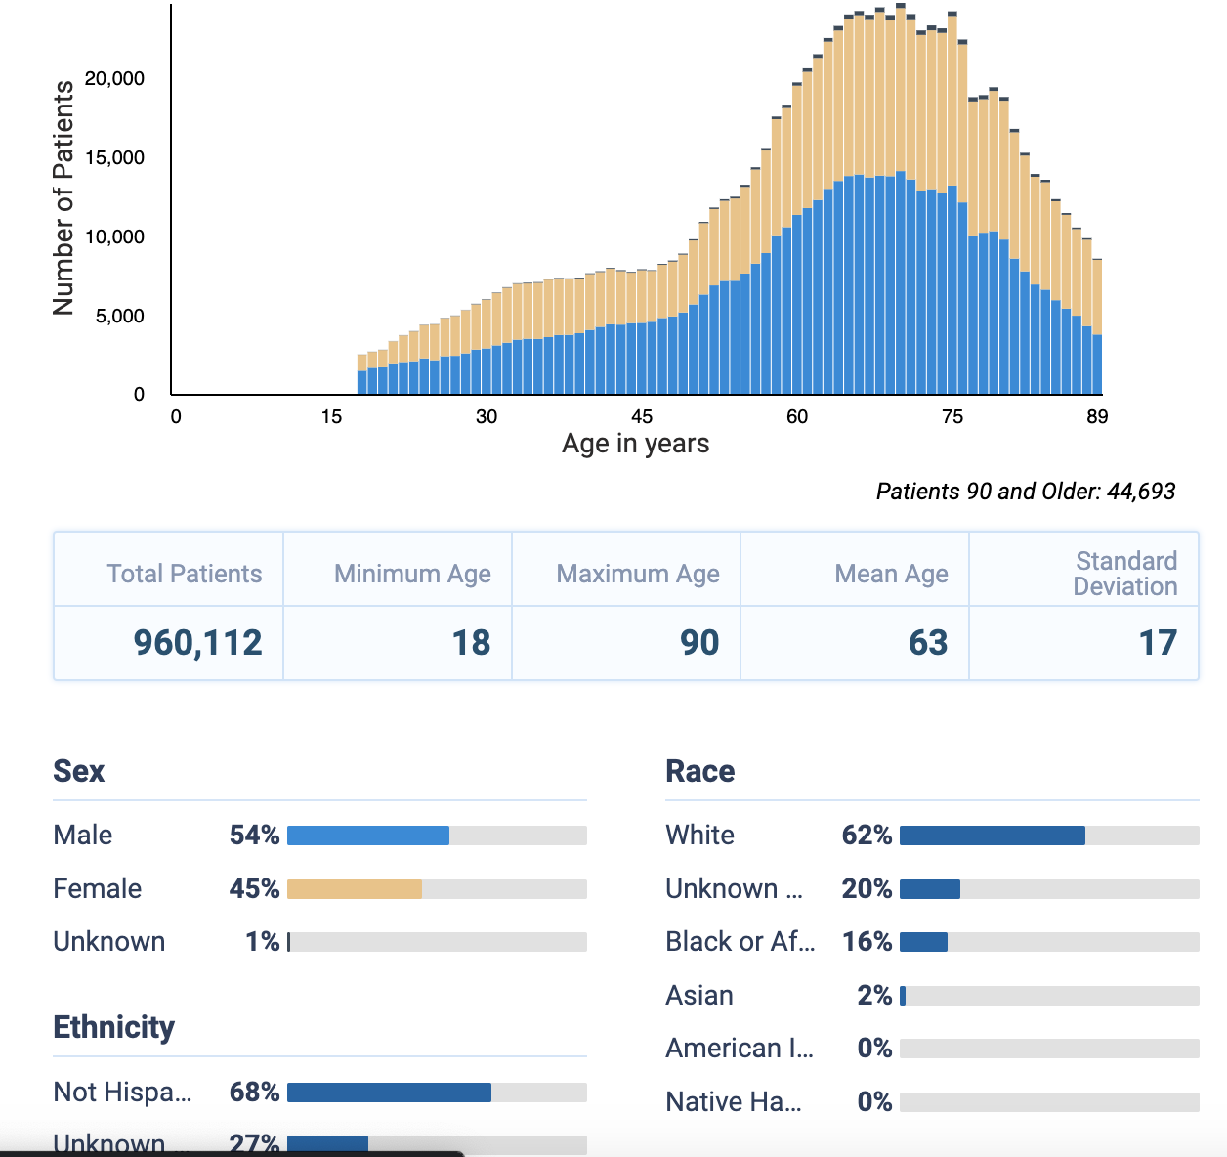
Data sanity checking
 | Total | ABG Group | ICD Group | Procedure Group
 | N=785,667 | N=678,424 | N=105,126 | N=2,117
Age | 60 (16) | 60 (17) | 62 (16) | 52 (19)
Gender | 46% (360,445) | 45% (304,832) | 52% (54,726) | 42% (887)
Asian | 1% (9,673) | 1% (8,420) | 1% (1,245) | 0% (8)
Black | 18% (138,026) | 18% (119,911) | 17% (18,026) | 4% (89)
Native American / Alaska Native | 0% (3,545) | 0% (3,041) | 0% (504) | 0% (0)
Native Hawaiian / Pacific Islander | 0% (800) | 0% (644) | 0% (156) | 0% (0)
White | 62% (489,151) | 62% (418,632) | 66% (68,948) | 74% (1,571)
Latino | 6% (31,744) | 6% (27,896) | 7% (3,818) | 2% (30)
Location
ex | 10% (73,473) | 11% (72,632) | 1% (841) | 0% (0)
midwest | 16% (123,411) | 17% (114,279) | 10% (9,132) | 0% (0)
northeast | 23% (177,929) | 22% (148,086) | 34% (29,843) | 0% (0)
south | 45% (348,616) | 47% (316,478) | 34% (30,021) | 100% (2,117)
west | 6% (43,175) | 4% (23,934) | 22% (19,241) | 0% (0)
split out group membership into 3 binaries (yes/no ABG, yes/no ICD, yes/no Procedure)
- currently too few procedure. But, that may be a function of sequential evaluation of criteria?

Slide 7
Admission VS (skewed center) e.g. for BMI – version w missing data?
 | Total | ABG Group | ICD Group | Procedure Group
 | N=785,667 | N=678,424 | N=105,126 | N=2,117
Age | 60 (16) | 60 (17) | 62 (16) | 52 (19)
Gender | 46% (360,445) | 45% (304,832) | 52% (54,726) | 42% (887)
BMI | 24 (5) | 24 (5) | 24 (6) | 24 (4)
Respiratory Rate | 15 (3) | 15 (3) | 15 (3) | 14 (0)
Temperature (C) | 37 (1) | 37 (1) | 37 (1) | 37 (0)
Systolic BP | 123 (19) | 123 (19) | 123 (17) | 122 (12)
Diastolic BP | 73 (12) | 72 (12) | 74 (11) | 75 (7)
Other features: [ ] spo2? o2?

Slide 8
Inpatient medication categories
 | Total | ABG Group | ICD Group | Procedure Group
 | N=785,667 | N=678,424 | N=105,126 | N=2,117
Age | 60 (16) | 60 (17) | 62 (16) | 52 (19)
Gender | 46% (360,445) | 45% (304,832) | 52% (54,726) | 42% (887)
PO Corticosteroid | 41% (320,131) | 41% (281,124) | 37% (38,901) | 5% (106)
Narcan or other antidote | 23% (183,224) | 25% (167,285) | 15% (15,896) | 2% (43)
Inhaled Treatments Rx'd | 37% (293,266) | 37% (252,748) | 38% (40,403) | 5% (115)
Vasodilators | 14% (107,701) | 14% (97,077) | 10% (10,554) | 3% (70)
[ ] inpatient diuretics???

Slide 9
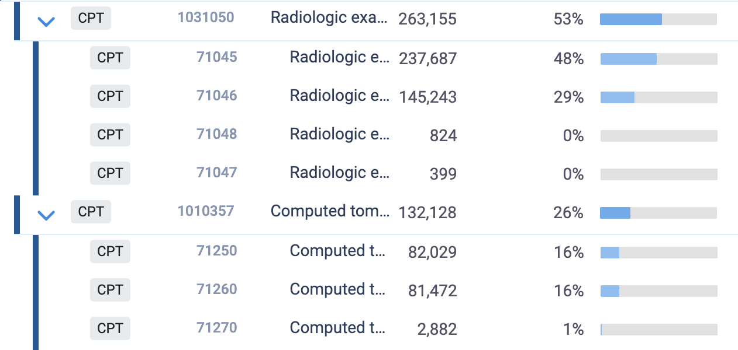
Procedures. No TTE, EMG/NCS, PSG. No crit care time?
 | Total | ABG Group | ICD Group | Procedure Group
 | N=785,667 | N=678,424 | N=105,126 | N=2,117
Age | 60 (16) | 60 (17) | 62 (16) | 52 (19)
Gender | 46% (360,445) | 45% (304,832) | 52% (54,726) | 42% (887)
CPAP proc. code | 7% (58,615) | 6% (43,070) | 15% (15,524) | 1% (21)
Aerosolized Treatment | 15% (119,865) | 14% (97,697) | 21% (22,093) | 4% (75)
Inhaler Teaching | 3% (22,402) | 3% (19,943) | 2% (2,401) | 3% (58)
1 View CXR | 23% (177,806) | 22% (147,529) | 29% (30,156) | 6% (121)
2 View CXR | 6% (46,579) | 6% (39,661) | 7% (6,903) | 1% (15)
CT Chest Non-Contrast | 4% (32,650) | 4% (27,317) | 5% (5,325) | 0% (8)
CT Chest w Contrast | 4% (30,349) | 4% (26,256) | 4% (4,072) | 1% (21)
Notes:
Critical care services?

Slide 10
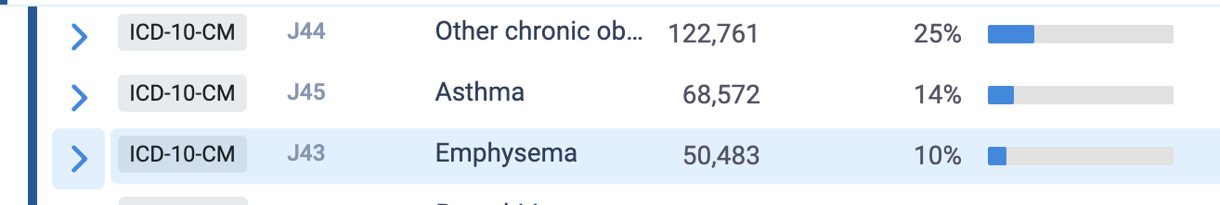
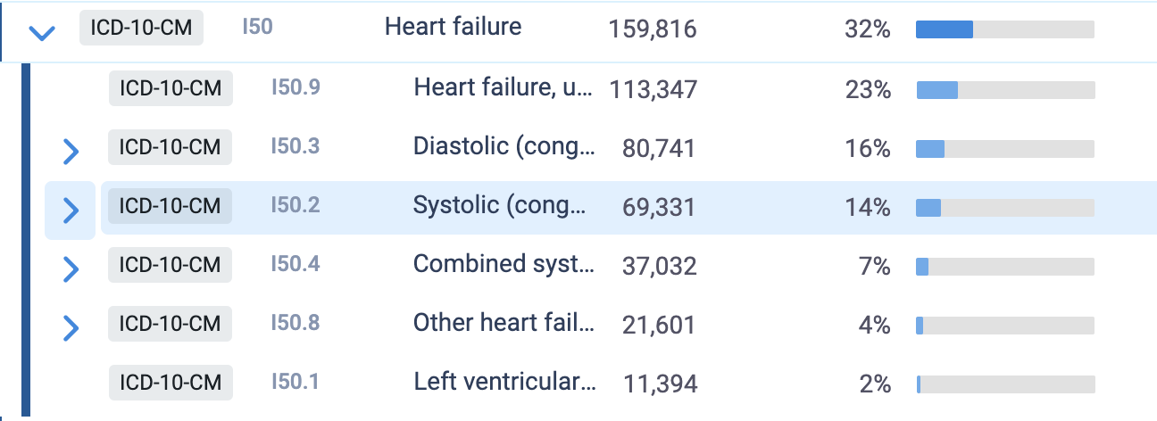
Chronic conditions: Heart failure high – rest not?
 | Total | ABG Group | ICD Group | Procedure Group
 | N=785,667 | N=678,424 | N=105,126 | N=2,117
Age | 60 (16) | 60 (17) | 62 (16) | 52 (19)
Gender | 46% (360,445) | 45% (304,832) | 52% (54,726) | 42% (887)
Asthma | 0% (2,934) | 0% (1,828) | 1% (1,106) | 0% (0)
Cystic Fibrosis | 0% (1,226) | 0% (1,041) | 0% (185) | 0% (0)
CHF | 21% (166,238) | 19% (130,533) | 34% (35,641) | 3% (64)
CKD | 1% (5,485) | 1% (3,698) | 2% (1,787) | 0% (0)
COPD | 0% (1,680) | 0% (1,232) | 0% (448) | 0% (0)
Connective Tissue Disease | 0% (1,112) | 0% (813) | 0% (299) | 0% (0)
Dementia | 0% (2,076) | 0% (1,394) | 1% (682) | 0% (0)
Diabetes | 1% (7,894) | 1% (5,274) | 2% (2,620) | 0% (0)
Nicotine dependence | 1% (4,727) | 0% (3,250) | 1% (1,477) | 0% (0)
Neuromuscular Disease | 0% (924) | 0% (673) | 0% (251) | 0% (0)
OSA | 1% (5,675) | 1% (3,523) | 2% (2,152) | 0% (0)
Opiate Use Disorder | 0% (936) | 0% (680) | 0% (256) | 0% (0)
Pulmonary Hypertension | 0% (2,703) | 0% (1,675) | 1% (1,028) | 0% (0)
Peripheral Vascular Disease | 0% (2,095) | 0% (1,666) | 0% (429) | 0% (0)
Stroke | 0% (2,124) | 0% (1,734) | 0% (390) | 0% (0)

Slide 11
for labs e.g. ( value_27441 (ABG pH) )- missing values are currently 0. They should be 7.4 (should we mean center?). Also exclude <6.5 and above 7.8
// what is value 21600?
 | Total | ABG Group | ICD Group | Procedure Group | p-value
 | N=785,667 | N=678,424 | N=105,126 | N=2,117
Age | 60 (16) | 60 (17) | 62 (16) | 52 (19) | <0.001
Gender | 46% (360,445) | 45% (304,832) | 52% (54,726) | 42% (887) | <0.001
pH (ABG) | 7.32 (0.11) | 7.32 (0.11) | 7.37 (0.12) |  | <0.001
HCO3 (ABG) | 24.8 (6.3) | 24.8 (6.3) | 21.6 (5.8) |  | <0.001
pH (VBG) | 7.35 (0.12) | 7.35 (0.12) | 7.33 (0.12) |  | <0.001
HCO3 (VBG) | 25.5 (6.6) | 25.4 (6.5) | 26.6 (7.4) |  | <0.001
Serum Sodium | 138 (5) | 138 (5) | 138 (5) | 137 (5) | <0.001
Serum Hemoglobin | 12.1 (2.5) | 12.1 (2.5) | 12.2 (2.6) | 13.0 (2.5) | <0.001
[ ] --- this is true for all of the values. Physiologic bicarb 0-60. Add robustness checks

Slide 12
TODO: still need to sanity check acute diagnoses.

Slide 13
PCA output
Knowing which data features are the major contributors to the principal components might guide which data elements should be included in future models?
  Is the PCA useful on its own?
PCA: feature generation for other algorithms
  Which algorithms and for what purpose?
    K-means clustering -> what would this get us?
    Regression?
Notes:
Do Tuesday afternoons at 4pm work for you for ongoing meetings? For the upcoming semester, we were hoping to identify a time that doesn’t conflict with Krishna’s schedule
In brainstorming the analysis we will run on the dataset, do these use-cases for the data sound correct?
The principal components themselves can be used as inputs to classifiers (either clustering e.g. k-means; or classification with logistic regression or something similar)

Slide 14
Partial verification formulation:
ABG is reference standard, but how well can things like VBG work as imperfect standards?
Latent class approach?
Notes:
Differential verification approach: Participants whose disease status was not verified with the gold standard could undergo another reference standard (that is imperfect or less invasive than the gold standard [84]) to ascertain their disease status. This is known as differential verification [200]. Differential verification has been explored Alonzo et al, De Groot et al and Naaktgeboren et al [200–202]. They discussed the bias associated with differential verification, and how results using this approach could be presented. There are three identified statistical methods in this group. They are: a Bayesian latent class approach proposed by De Groot et al [82], a Bayesian method proposed by Lu et al [203] and a ROC approach proposed by Glueck et al [16]. These three methods aim to simultaneously adjust for differential verification bias and reference standard bias that arises from using an alternative reference standard (i.e. imperfect reference standard) for participants whose true disease status was not verified with the gold standard.
https://journals.plos.org/plosone/article?id=10.1371/journal.pone.0223832

Slide 15
Expanded Data Set
Target population: all patients in whom a clinician would consider that the patient has acute hypercapnic respiratory failure
Analytic sample: widened criteria that includes both patients who had hypercapnic failure, and patients who might reasonably have been expected to. (at admission)
Notes:
For the (b) use case with a classifier; and for the ATS abstract where we looked at the predictive value of bicarbonate in a spectrum of locations: I think, the right population to run the analysis would be in “Patients that a clinician would have some suspicion of hypercapnia, but including both patients who have it and those who don’t” (ie. the expanded use criteria we discussed when re-requesting data a month or two ago. It seems like eventually we’ll want to grab this data-set from trinetx… should we start the wheels now?

Slide 16
need robust truthfulness of data… integrity checks
Aim: only patient admissions where all the types of data needed WOULD have been reported if they were obtained in clinical care.
  For diagnoses, only diagnosis that were known/made prior to that time.

Slide 17
Next steps:
[ ] split out group membership into 3 binaries (yes/no ABG, yes/no ICD, yes/no Procedure)
- currently too few procedure. But, that may be a function of sequential evaluation of criteria?
[ ] version with missing data left missing (as opposed to mean) - -- how should we handle missing data?
[ ] also a version with the “criteria” data – ie. ABG PaCO2, hypercapnia codes, and ICD for NIV included
Problematic features: why no PSG EMG and NCS billed in the entire dataset? - restrictions on location of care?. Yet, TTE also isn't but clearly that is done inpatient frequently.
What pre-screening can we do to improve the completeness of the sample?
- require at least 1 result from all categories to be included?
- eliminate iatrogenic cases... somehow?
Notes:
Frequency of certain conditions
-- only 5000 have OSA? --- this must be from acute encounter. Same with all resp... but NOT CHF
[ ] todo: check what the trinetx dashboard estimates for these.
// which antidotes drive the high number of those? (1/8 of cohort)
// why so many MAT but so few nicotine meds?

Slide 18
Structure to final paper:
Currently used methods A, B, C, and D over-selected ___ type and underselected ___ type compared to ____
Possible features from the data that could be used to identify, or phenotype, patients include ____
For research that aims to enroll a representative sample of patients to estimates the prognosis, burden to the healthcare system, or improve processes of care should consider ____ to identify these patients.
A future prospective study evaluating the performance of these methods is warranted.
Notes:
Will need to make the disclaimer about clinical use vs use for epidemiologic study

Slide 19
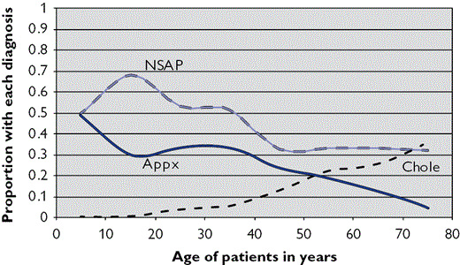
Stratifying causes
Also from that - could I create —> key figure of comorbidities by age in hypercapnia.
By age? by BMI ; stratified by gender

Slide 20
U of U Data
[ ] IRB and data request

